Slide 1
What do i with python?
Guillaume THOMAS

Slide 2
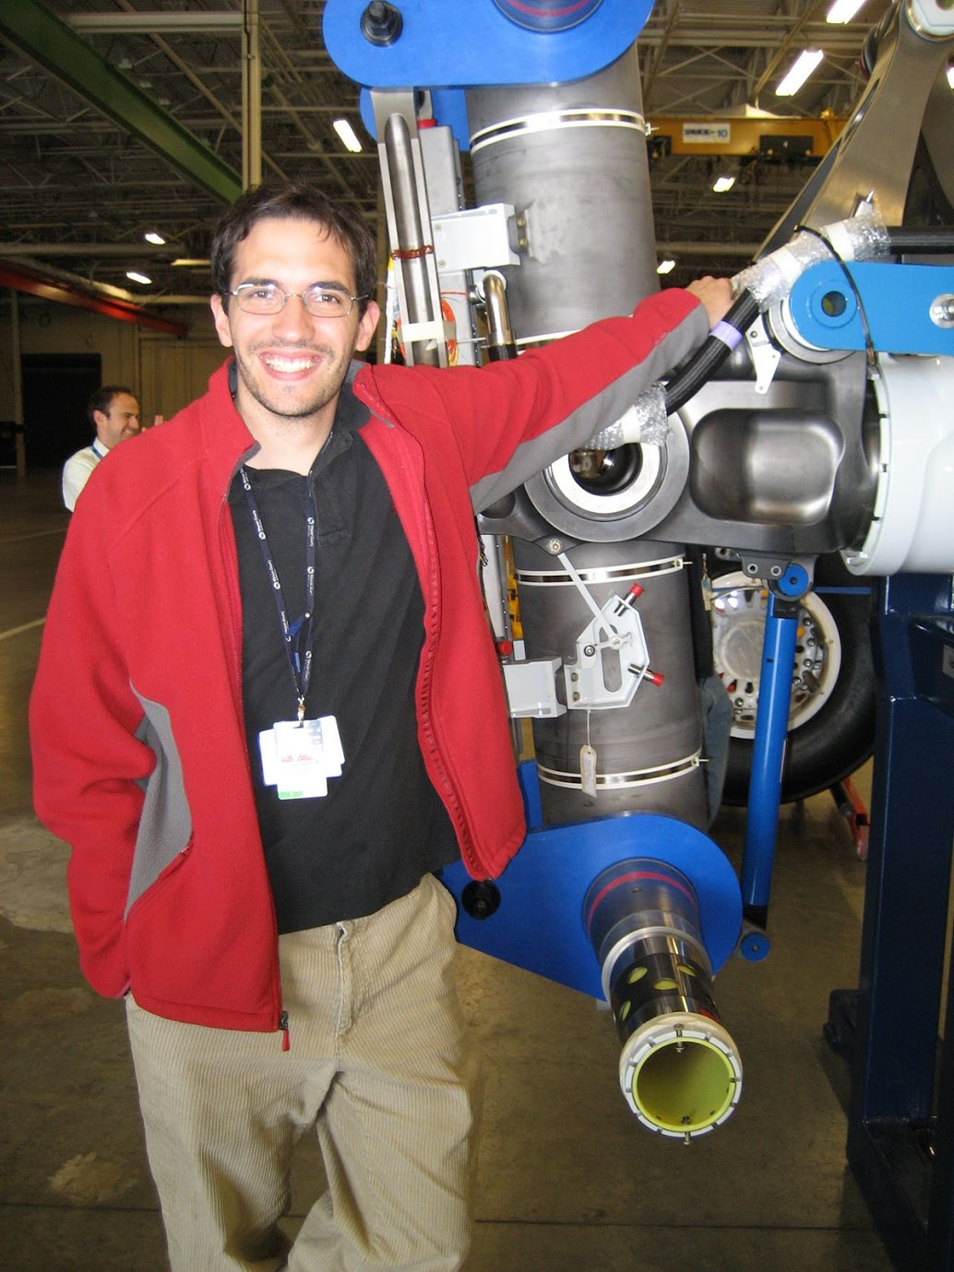
About me :
https://github.com/guillaumethomas
Landing Gear Designer, Nuclear Scientist, Airplane seat Design % Crash Test

Slide 3
Pas & Current project
Math problem for my son
Looking at my stock portfolio using google library
GPX Analysis to verify strava accurary
Currently using a raspberry Pi as my « working horse »to
Develop safely using rsub package to edit file with sublime from my mac over ssh
Sync NAS using python script and tmux connection or nohup shell command

Slide 4
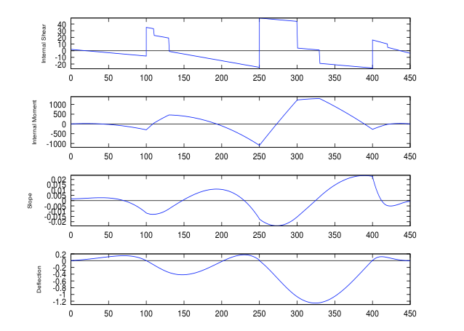
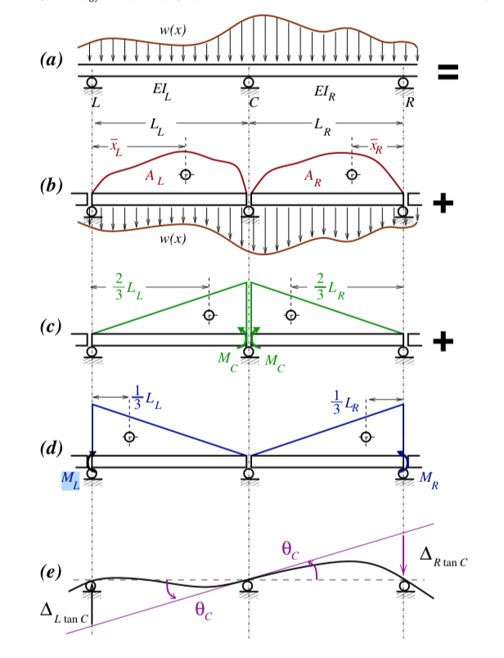
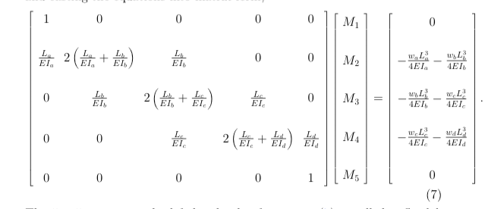
Future Project
A bit of classical problem in mechanic
3 moment method
Various mech sizing problem
Connection to the strava API for backend analysis
Remote back up using raspberry pis to connect to and from a friend place

